Slide 1

Docker basics
April, 2020

Slide 2
What is Docker
Open source new generation virtualization software
Allows to package an application with all of its dependencies into a standardized unit
Unlike virtual machines, containers do not have high overhead and hence enable more efficient usage of the underlying system and resources.

Slide 3
Docker Enterprise or Community
Docker EE – Enterprise Edition
Paid version. 7/24 support, certified images, additional enterprise functions (management)
Docker CE
Completely free, community supported
CE and EE have the same core features and functions

Slide 4
Prerequisties
Disable selinux
/etc/selinux/config
SELINUX=disabled
OPTIONAL INSTALL CENTOS EPEL REPOSITORY
# yum install epel-release

Slide 5
Get Docker
SET UP THE REPOSITORY
Install the yum-utils package (which provides the yum-config-manager utility) and set up the stable repository.
# sudo yum install -y yum-utils device-mapper-persistent-data lvm2
# sudo yum-config-manager --add-repo https://download.docker.com/linux/centos/docker-ce.repo
#sudo yum install docker-ce docker-ce-cli containerd.io
#systemctl start docker
#systemctl enable docker
#docker –-version
Docker version 19.03.8, build afacb8b
INSTALL DOCKER ENGINE

Slide 6
Concepts
Images
The blueprints of our application which form the basis of containers.
Containers
Created from Docker images and run the actual application.
Docker Daemon
The background service running on the host that manages building, running and distributing Docker containers.
Docker Client
The command line tool that allows the user to interact with the daemon.
Docker Hub
A registry of Docker images. You can think of the registry as a directory of all available Docker images.

Slide 7
Let’s get our hands dirty
Create our first packaged application
A simple webapplication that runs on lightweight Alpine linux with Nginx and shows a static webpage.
What we need to do
Alpine linux as a base image
Install and configure (Nginx, folders, etc.)
Place index.html in the public directory
Run

Slide 8
Dockerfile
Docker can build images automatically by reading the instructions from a Dockerfile. A Dockerfile is a text document that contains all the commands a user could call on the command line to assemble an image. Using docker build users can create an automated build that executes several command-line instructions in succession.
Important commands
FROM - the base image, eg. FROM alpine:3.6
RUN – it runs commands, eg. RUN apk add nginx
ADD – it copies files into image during build, eg. application codes, configfiles
WORKDIR – the default directory when one enters the container
CMD – when container starts, this is the default command that runs.

Slide 9
Sample dockerfile
Take a look at /app/docker-test/Dockerfile
Let’s build!
$ docker build -f Dockerfile -t test .
build: create image
-f Dockerfile - location of Dockerfile descriptor
-t apply a tag to the image, eg test or application:1.0
. Specify the context directory (build will use commands relative from there)
ending build context to Docker daemon 15.36kB
Step 1/13 : FROM alpine:3.6
…
Successfully built 76fc926cd406
Successfully tagged test:latest

Slide 10
Where is my stuff?
#docker images
REPOSITORY TAG IMAGE ID CREATED SIZE
test latest 9402fceecfe5 8 seconds ago 151MB
alpine 3.6 43773d1dba76 13 months ago 4.03MB
By default it’s not started. When you run an image, a container is created.

Slide 11
Running images
$ docker –d –name mytestapp –p 80:80 run test
It’ll start with the default CMD – supervisord.
$ docker run test echo “Welcome” would run just a simple command.
-d stands for detached mode. When it’s skipped, it will be foreground.
--name name the container. When skipped a random name is created
-p 80:80 will map host’s port 80 to container’s port 80
Check running containers
#docker ps (-a will list stopped/exited ones)
You may log in to running containters
$ docker exec –it test /bin/sh

Slide 12
Persistency
Docker containers are not persistent. If you change of modify anything it will be lost upon next run*. You should use legacy bind or docker volumes.
There are two ways make data persistent, eg. database files.
Legacy bind
-v hostdir:containerdir
-mount (more options and readable)
Docker volumes
$ docker volume create my-vol
$ docker volume ls
$ docker volume inspect my-vol
--mount source=myvol2,target=/app \
*docker commit is available, thought. It’ll create a new image with changes. We consider it pretty illegal from CI/CD perspective

Slide 13
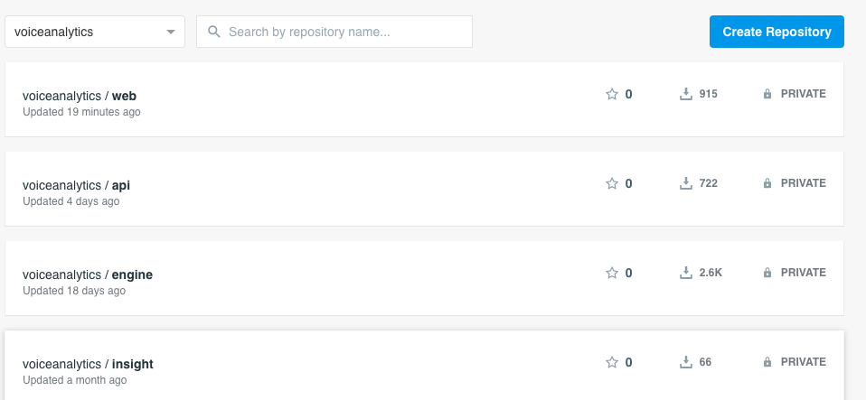
CI / CD options
Register to docker.com repository

Slide 14
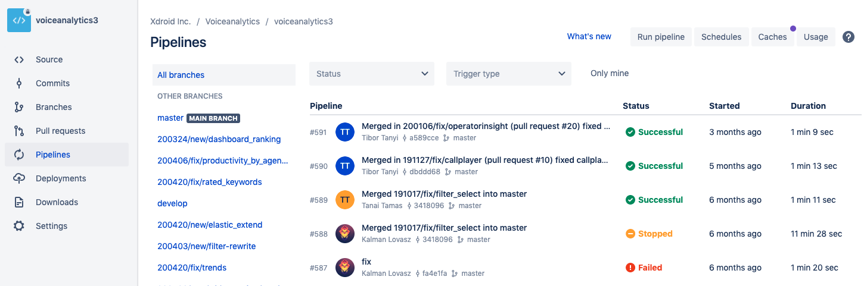
Git repository
Most GIT providers support of automatic docker builds using Pipelines
Eg. bitbucket, gitlab etc.
A dockerfile is put in the codebase
Pipeline can be configured to start automatic build upon commit (eg. commit in master branch)

Slide 15
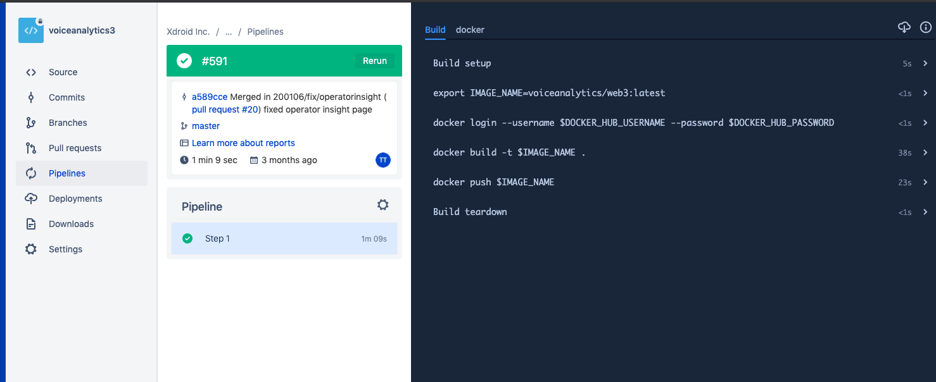
Pipeline -> automated new version

Slide 16
Upgrade online/offline
Online
$ docker login
Need only once at server side
$ docker pull voiceanalytics/web3
Also, docker images can be exported and can be manually imported at customer side
$ docker export voiceanalytics/web3 web3.tar
$ docker load –i web3.tar

